Slide 1

Numerical Differentiation
prepared by Razana Alwee
Notes:
prepared by Razana Alwee

Slide 2
Numerical Differentiation
Numerical differentiation requires us to find estimates for the derivative or slope of a function by using the function values at only a set of discrete points.
Numerical differentiation is used because some functions are unknown or difficult (or impossible) to differentiate exactly.
One must be very careful when using numerical techniques to estimate the rate of change of measured data, since small errors are exaggerated by differentiation.
prepared by Razana Alwee

Slide 3
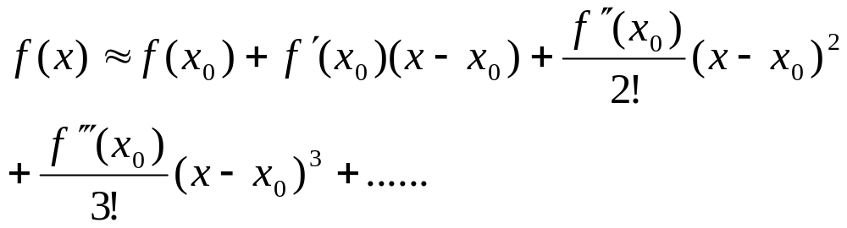
Taylor polynomials
There are several formulas for approximating a first and second derivatives and these formulas can be found with the use of Taylor polynomials.
Taylor polynomials, f(x) at x₀ is,
prepared by Razana Alwee

Slide 4
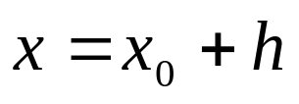
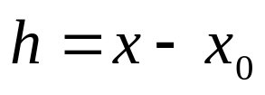
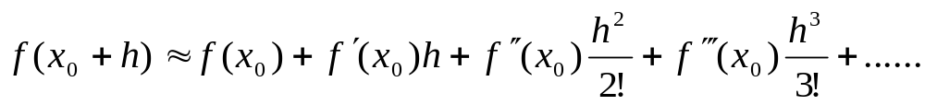
Taylor polynomials
Let,
prepared by Razana Alwee

Slide 5
First Derivatives
2 point formulas
  Forward difference formula
  Backward difference formula
3 point formulas
  Forward difference formula
  Backward difference formula
  Central difference formula
5 point formulas
  Forward difference formula
  Central difference formula
prepared by Razana Alwee

Slide 6
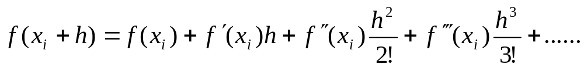
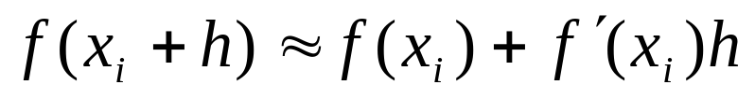
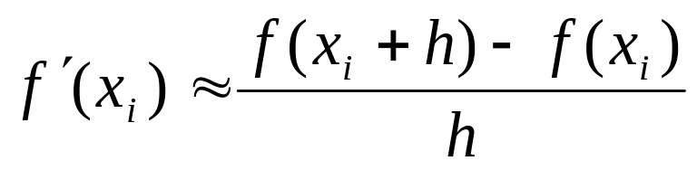
Two-point formulas
Forward difference formula
prepared by Razana Alwee

Slide 7
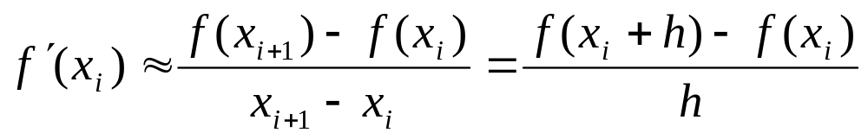
Two-point formulas
Forward difference formula
prepared by Razana Alwee

Slide 8
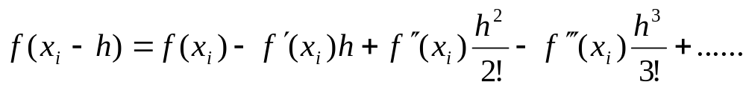
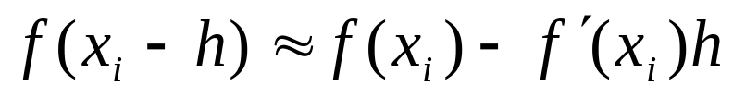
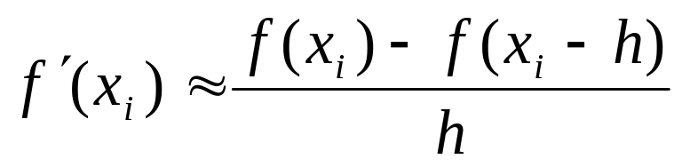
Two-point formulas
Backward difference formula
prepared by Razana Alwee

Slide 9
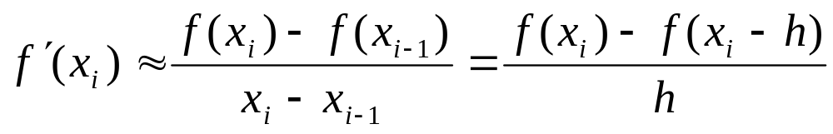
Two-point formulas
Backward difference formula
prepared by Razana Alwee

Slide 10
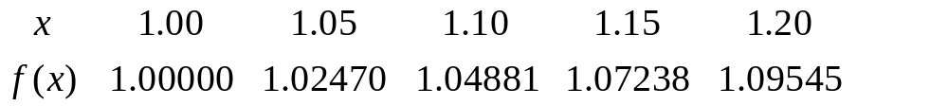
Example
Given the following data:
Use forward and backward two-point formulas to estimate f′(1.05).
prepared by Razana Alwee

Slide 11
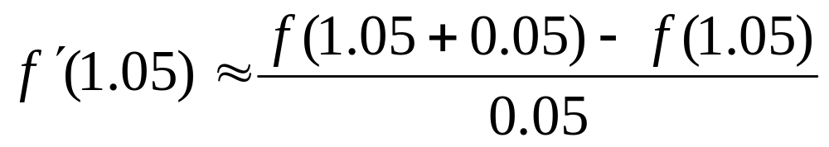
Example
Forward difference formula
prepared by Razana Alwee

Slide 12
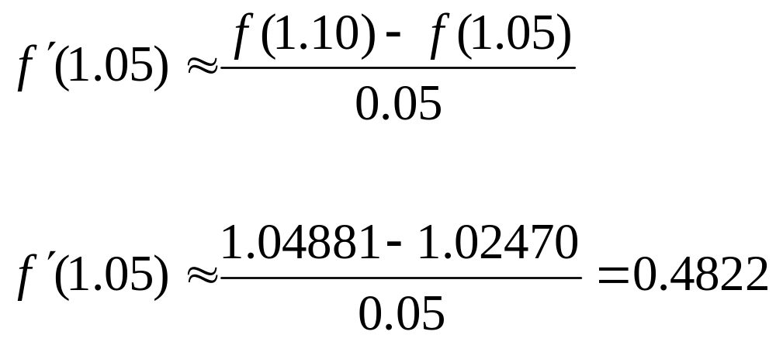
Example
prepared by Razana Alwee

Slide 13
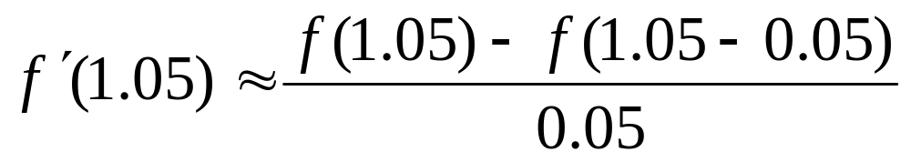
Example
Backward difference formula
prepared by Razana Alwee

Slide 14
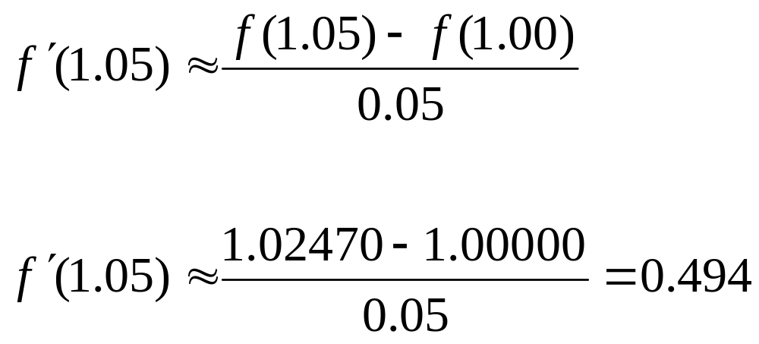
Example
prepared by Razana Alwee

Slide 15
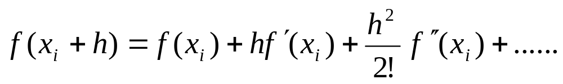
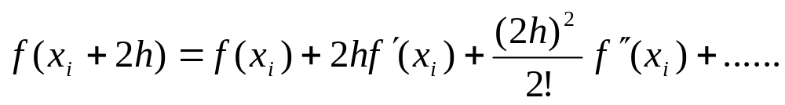
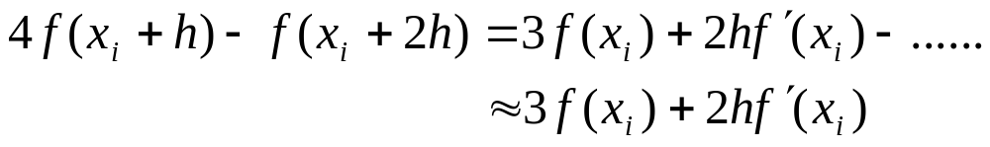
Three-point formulas
Forward difference formula
prepared by Razana Alwee

Slide 16
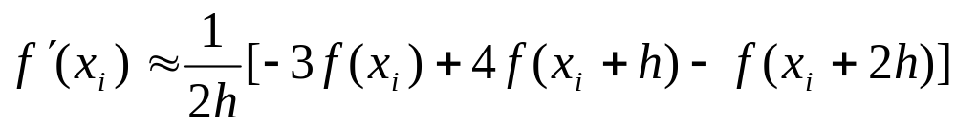
Three-point formulas
Forward difference formula
prepared by Razana Alwee

Slide 17
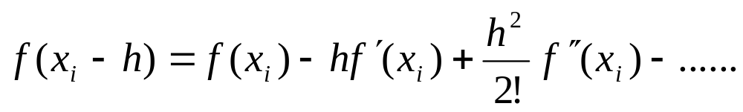
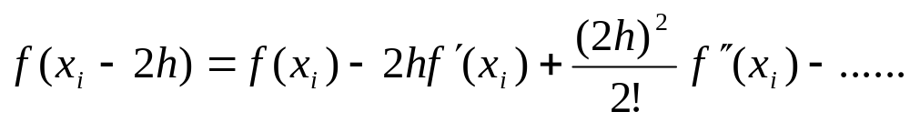
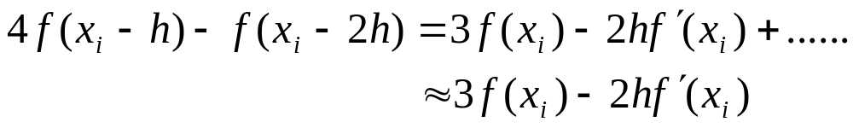
Three-point formulas
Backward difference formula
prepared by Razana Alwee

Slide 18
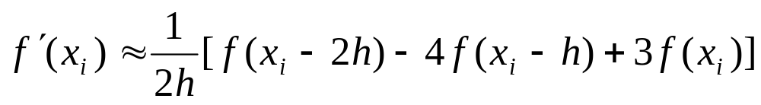
Three-point formulas
Backward difference formula
prepared by Razana Alwee

Slide 19
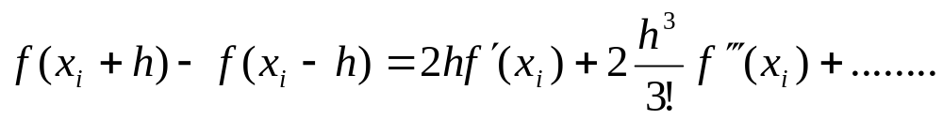
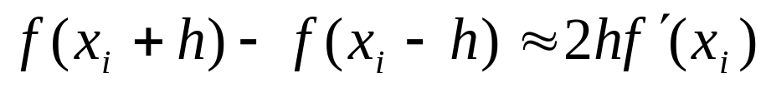
Three-point formulas
Central difference formula
prepared by Razana Alwee

Slide 20
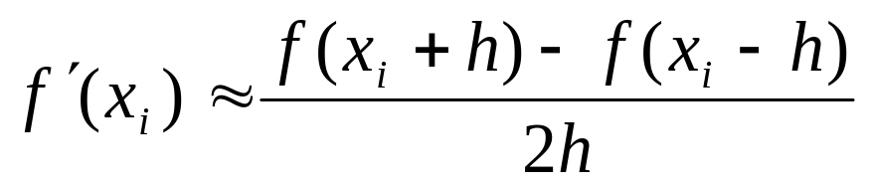
Three-point formulas
Central difference formula
prepared by Razana Alwee

Slide 21
Example
Given the following data:
Use forward, backward and central three-point formulas to estimate f′(1.10).
prepared by Razana Alwee

Slide 22
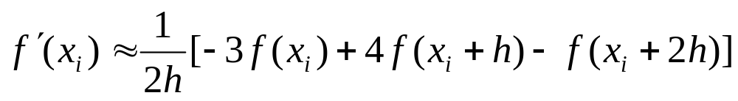
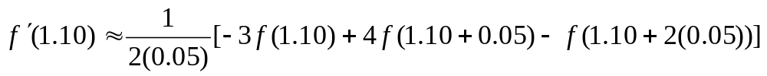
Example
Forward difference formula
prepared by Razana Alwee

Slide 23
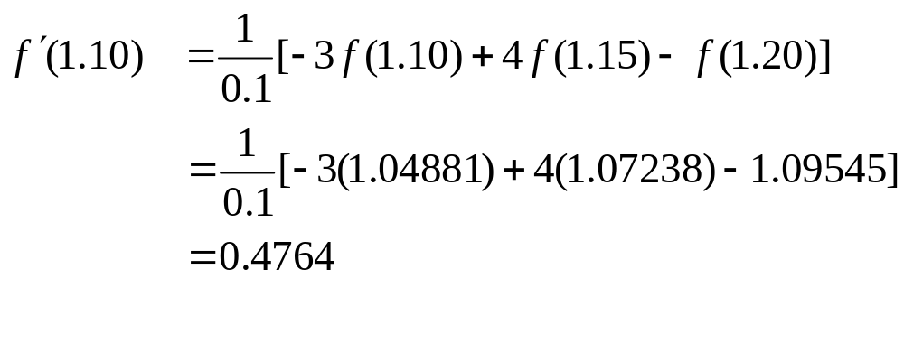
Example
Forward difference formula
prepared by Razana Alwee

Slide 24
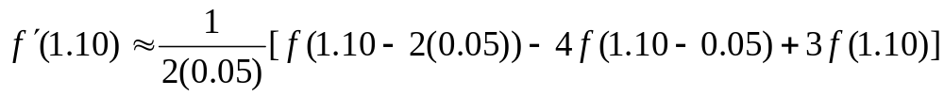
Example
Backward difference formula
prepared by Razana Alwee

Slide 25
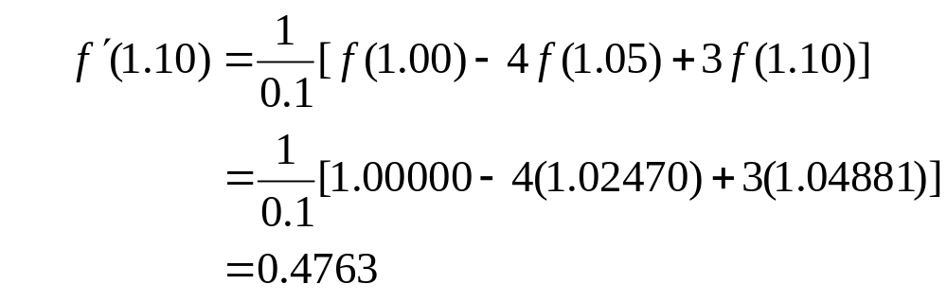
Example
Backward difference formula
prepared by Razana Alwee

Slide 26
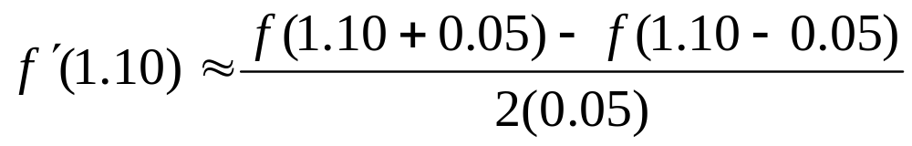
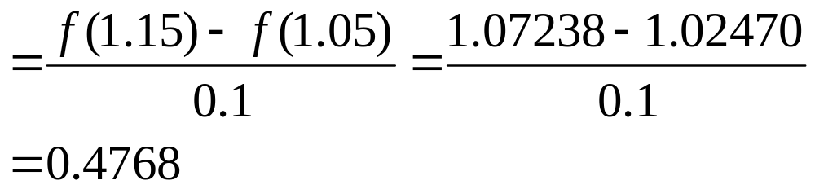
Example
Central difference formula
prepared by Razana Alwee

Slide 27
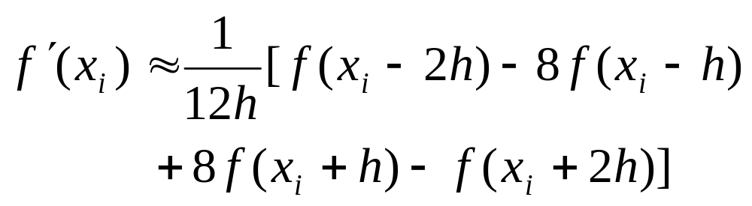
Five-point Formulas
Central difference formula
prepared by Razana Alwee

Slide 28
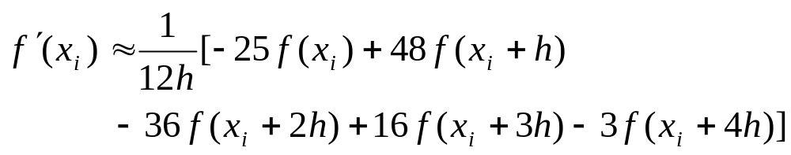
Five-point Formulas
Forward difference formula
prepared by Razana Alwee

Slide 29
Example
Given the following data:
Use forward and central five-point formulas to estimate f′(1.10).
prepared by Razana Alwee

Slide 30
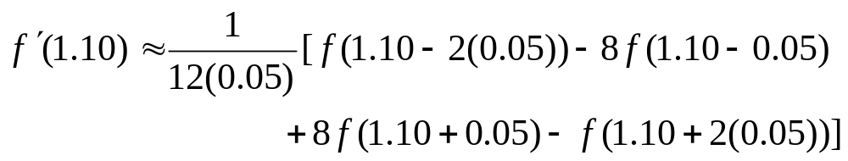
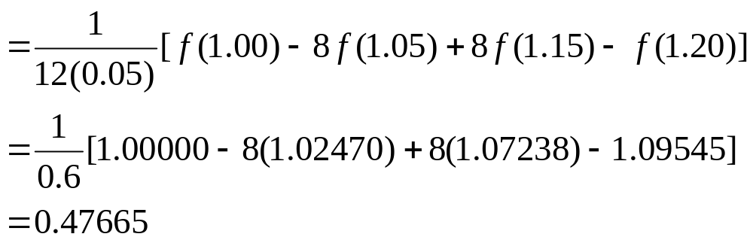
Example
Central difference formula
prepared by Razana Alwee

Slide 31
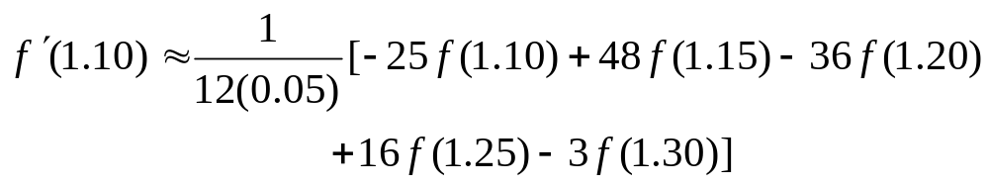
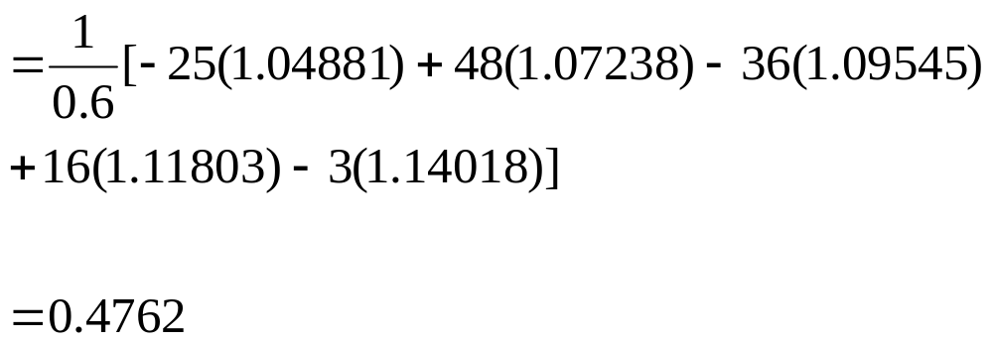
Example
Forward difference formula
prepared by Razana Alwee

Slide 32
In general, using more evaluation points with small values of h produces greater accuracy.
prepared by Razana Alwee

Slide 33
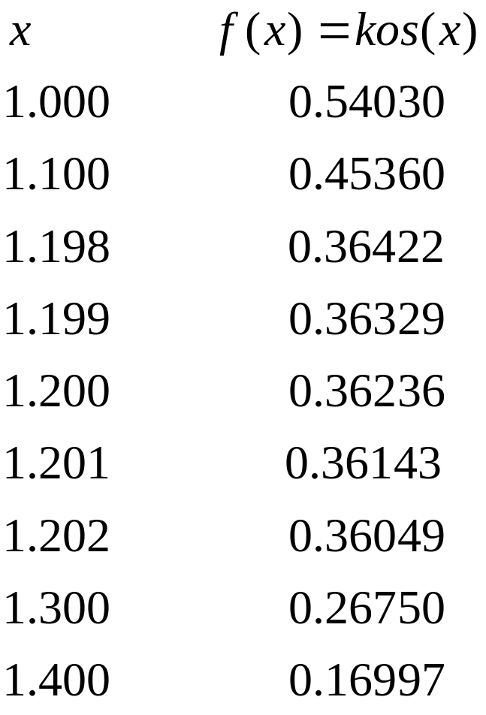
Exercise
Estimate f’(1.2) using
a) Forward and backward two-point formulas
Forward, backward, and central three-point formulas
Forward and central five-point formulas
with h=0.1and h=0.001.
Find the exact value of f’(1.2) and
calculate the error for each estimation.
prepared by Razana Alwee

Slide 34
Second Derivatives
3 point formulas
  Central difference formula
5 point formulas
  Central difference formula
prepared by Razana Alwee

Slide 35
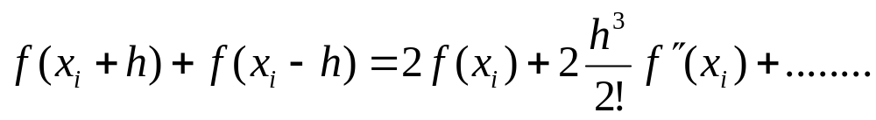
Three-point formulas
Central difference formula
prepared by Razana Alwee

Slide 36
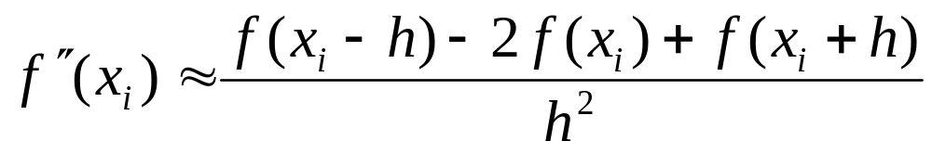
Three-point formulas
Central difference formula
prepared by Razana Alwee

Slide 37
Example
Given the following data:
Use central three-point formulas to estimate f′′ (1.10) with h=0.05
prepared by Razana Alwee

Slide 38
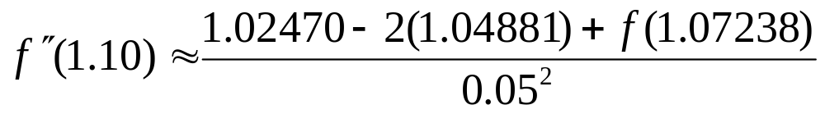

Example
Central three-point difference formula
prepared by Razana Alwee

Slide 39
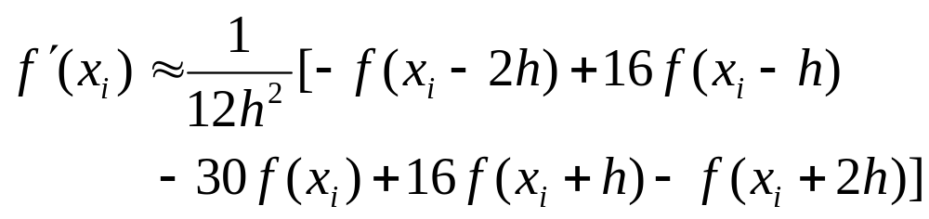
Five-point Formulas
Central five-point difference formula
prepared by Razana Alwee

Slide 40
Example
Given the following data:
Use central five-point formulas to estimate f′′ (1.10).
prepared by Razana Alwee

Slide 41
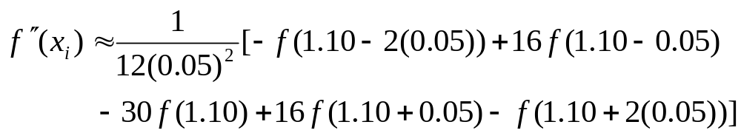
Example
Central difference formula
prepared by Razana Alwee

Slide 42
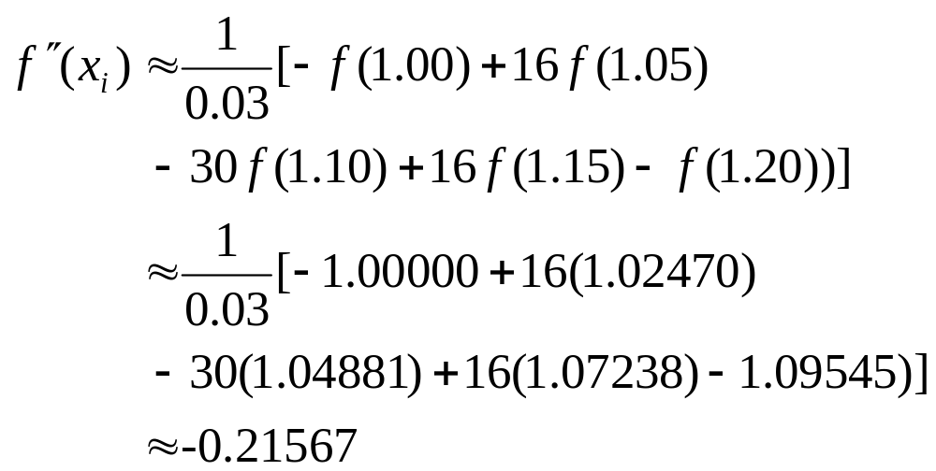
Example
Central five-point difference formula
prepared by Razana Alwee

Slide 43
Exercise
Estimate f’’(1.2) using
a) Central three-point formulas
b) Central five-point formulas
with h=0.1and h=0.001.
Find the exact value of f’’(1.2) and
calculate the error for each estimation.
prepared by Razana Alwee

